Slide 1


Effective Visual
Group 2: Tejaswani Yeruva
Kiran Kour
Vamshikrishna Sunnam
Rohit Charan
Sai Rohan Paritala

Slide 2
1) What observations can be made after reviewing the data in the Figure?
The new client tier share table details five tiers, including the number of accounts and revenue generated from each tier. Additionally, it displays the percentage of revenue and accounts contributed by each tier.
2) Do you have to make any assumptions when interpreting this data?
Every year, company ABC publishes new client tier share information to inform their customers about which tier will result in profits for them, as they always encourage their customers to become shareholders and join their corporate family. This client tier share summarizes each tier's performance in 2022 and can be used as a guide for clients making investment decisions in 2023.
3) What questions do you have about the data?
The following questions are raised by analyzing the data:
a.) What does New Client Tier Share indicate?
b.) How significant is each tier?
c.) How is the revenue generated?
d.) How are tiers, the number of accounts, and the revenue
closely linked?
FIG 2.1a
New client tier share
Tier | # of Accounts | % Accounts | Revenue ($M) | % Revenue
A | 77 | 7.08% | $4.68 | 25%
A+ | 19 | 1.75% | $3.93 | 21%
B | 338 | 31.07% | $5.98 | 32%
C | 425 | 39.06% | $2.81 | 15%
D | 24 | 2.21% | $0.37 | 2%

Slide 3
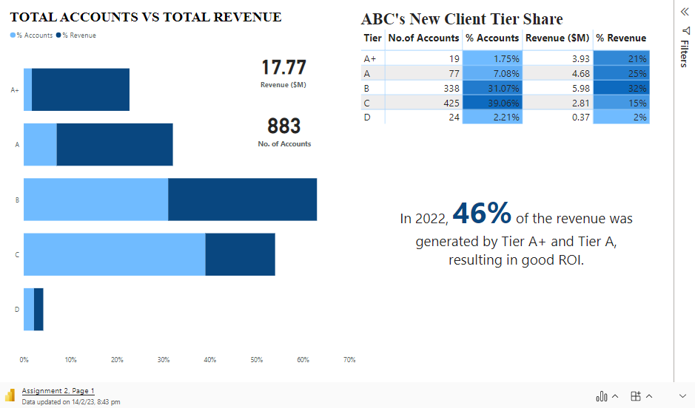

Slide 4
1.) Based on the ROI, the most profitable tiers to invest in, interpreted from the data, are A+ and A. 2.) An ideal tier would be Tier B based on the accounts holding and the revenue generation. Tier B contributes the maximum to the total revenue. 3.) As interpreted, even though Tier C holds the maximum share of accounts, it performs very poorly in revenue generation, making the clients question this tier’s reliability. 4.) Tier D, at the same time, is a poor-performing tier.
ABC'S New Client Tier Share
Tier | No. of Accounts | % Accounts | Revenue ($M) | % Revenue
A+ | 19 | 1.75% | $3.93 | 21%
A | 77 | 7.08% | $4.68 | 25%
B | 338 | 31.07% | $5.98 | 32%
C | 425 | 39.06% | $2.81 | 15%
D | 24 | 2.21% | $0.37 | 2%

